Slide 1
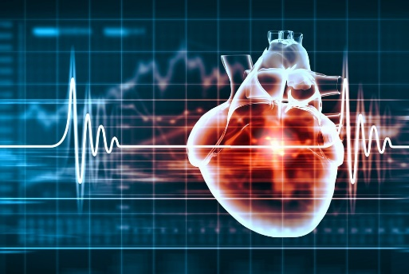
Heart Disease Prediction
Applied Regression Analysis Project
Dr. Nguyen
Fall 2019
Team Members: Karen Nogueira, Francisco Ortiz, Mudiha Wazirali

Slide 2
DATA ANALYSIS FLOW
1. Obtaining dataset
2. Defining research Questions
Determining response and regressor variables
3. Correlation Analysis
4. Data Exploration Analysis
Data Preprocessing
5. Original Logistic Regression Model
Stepwise Algorithm reduction
6. Reduced Logistic Regression Model
7. Models comparison
Anova (test= Chisq), AIC
8. Training and Predicting
Train data = 0.8, Testing data = 0.2
9. Evaluation of Accuracy
Confusion Matrix
10. Conclusions

Slide 3

1. DATASET
The Cleveland Heart Disease Data which consists of 14 variables measured on 303 individuals. This can be obtained from Kaggle following the next link: https://www.kaggle.com/ronitf/heart-disease-uci.
Variable Name | Class | Description
age | Numerical | The person's age in years
sex | Factor | The person's genre. 1 = male, 0 = female
cp | Factor | The chest pain type experienced; 0 = typical angina 1 = atypical angina 2 = non-anginal pain 3 = asymptomatic
trestbps | Numerical | The person's resting blood pressure (mm Hg on admission to the hospital)
chol | Numerical | The person's cholesterol serum measurement in mg/dl
fbs | Factor | The person's fasting blood sugar > 120 mg/dl; 1 = true, 0 = false
restecg | Factor | Resting electrocardiographic measurement; 0 = normal 1 = having ST-T wave abnormality 2 = showing probable or definite left ventricular hypertrophy
thalach | Numerical | The person's maximum heart rate achieved
exang | Factor | Exercise induced angina; 1 = yes, 0 = no
oldpeak | Numerical | ST depression induced by exercise relative to rest ('ST' relates to positions on the EKG plot)
slope | Factor | The slope of the peak exercise ST segment; 3 levels. 0 = upsloping 1 = flat 2 = downsloping
ca | Factor | The number of major vessels colored by fluoroscopy: 0-4 vessels
thal | Factor | Thallium stress test level. 0 -1 = normal 2 = fixed defect 3 = reversable defect
target | Factor | Heart disease. 0 = no, 1 = yes

Slide 4

2. RESEARCH QUESTIONS
What are the relationships between the regressors and the target variable?
What is the best model to predict a heart disease state?

Slide 5
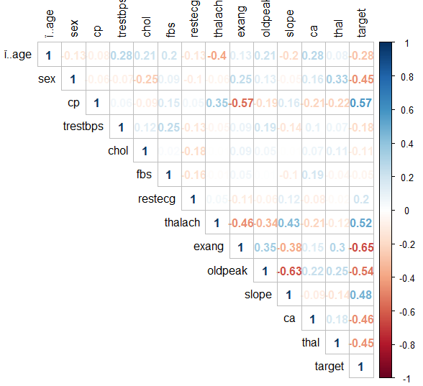
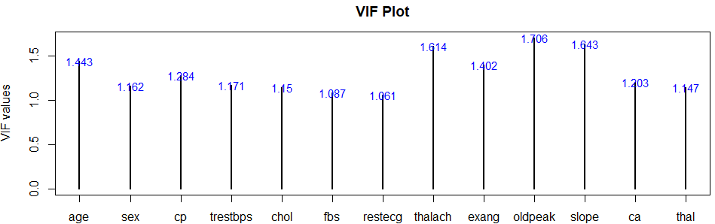
3. CORRELATION ANALYSIS

Slide 6
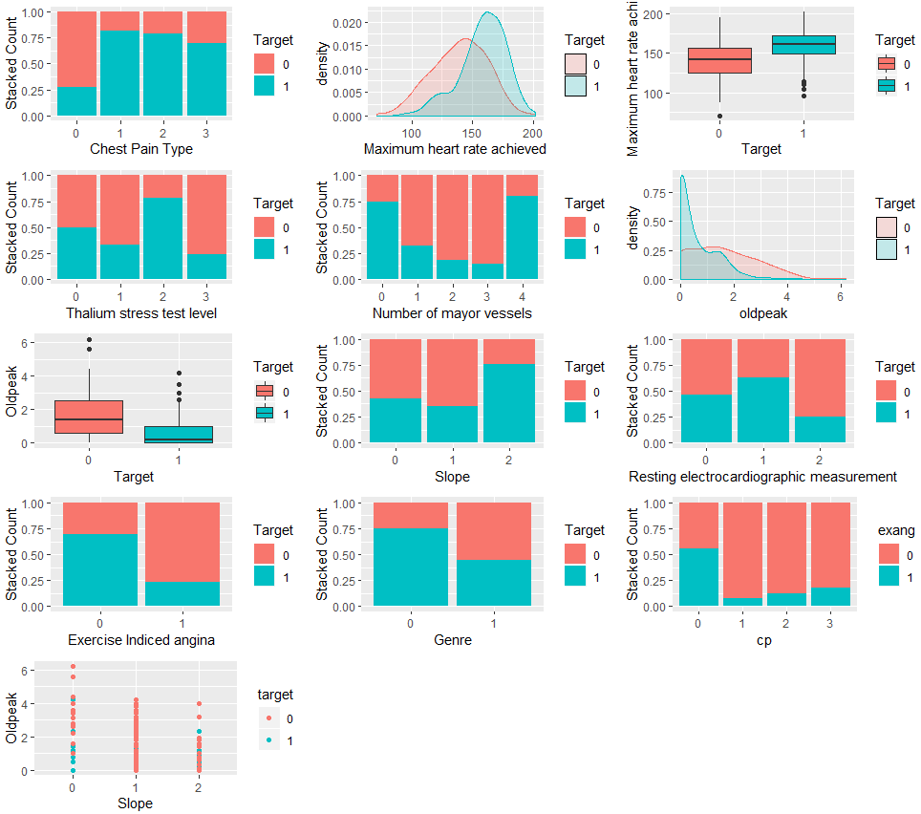
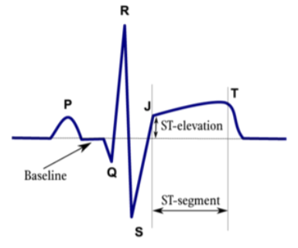
4. DATA EXPLORATION ANALYSIS

Slide 7
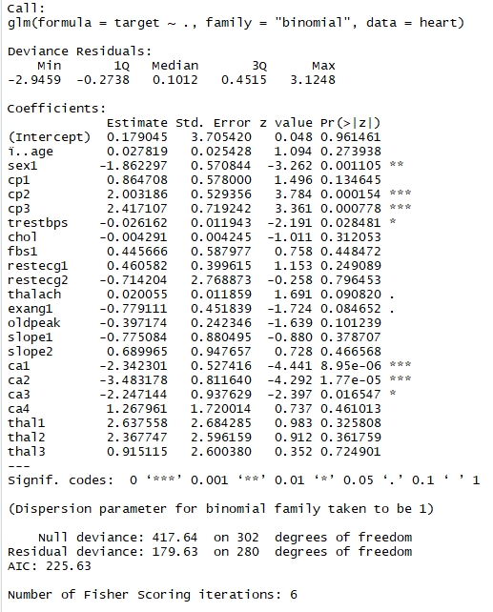
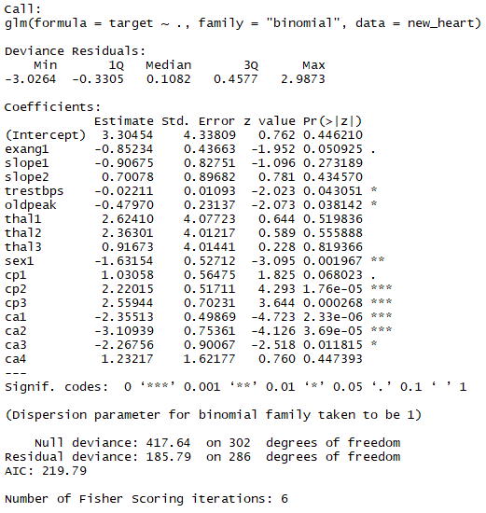
5, 6, 7. LOGISTIC REGRESSION MODELS
Original model (AIC = 225.63)
Reduced model (AIC = 219.79)

Slide 8
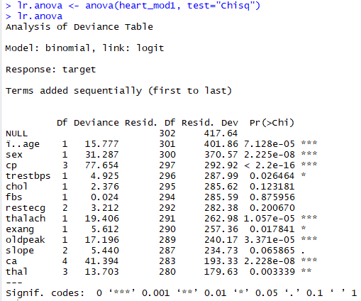
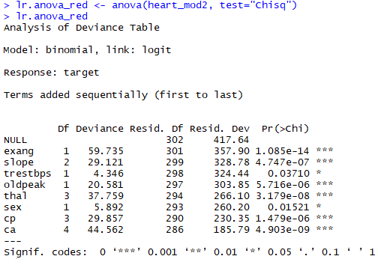
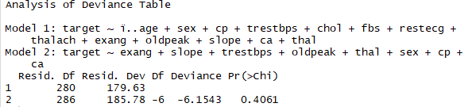
5, 6, 7. LOGISTIC REGRESSION MODELS
ANOVA
Original model
Reduced model
The variables chol, fbs, and restecg are not significant for the model
all the variables are significant at different levels of significance.
P-value based on chi-squared distribution indicates that we fail in reject the null Hypothesis which estates that the two models are equal. What this means is that the reduced model is better that the original containing all the regressor variables.

Slide 9
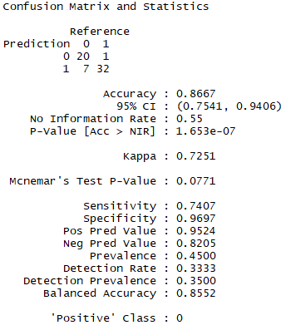
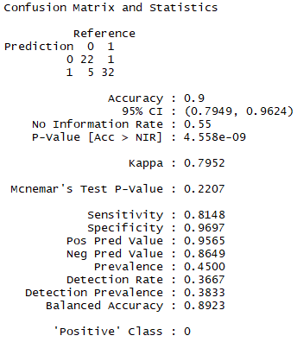
8. TRAINING AND PREDICTING
The distribution of the target attribute is 138 patients with positive diagnostic and 165 healthy people, indicating that there is not a problem of class imbalance
For each model, a random subset of the datasets of 80% represents the training datasets, and 20% the testing datasets.
9. ACCURACY EVALUATION
Original Prediction model
Reduced Prediction model
For the original dataset, Logistic Regression Modeling resulted in 86% of accuracy prediction. Whereas for the reduced dataset the prediction accuracy was 90%.
Both models are more specific than sensitive, which means that they predict better false negative cases.

Slide 10
10. CONCLUSIONS
The variables slope, exang, trestbps, oldpeak, thal, sex, cp, and ca are the features that play a significant role in driving the prediction of the heart disease condition.
These variables allowed for a prediction accuracy of 90% based on a logistic regression model, resulting in both a parsimonious and specific model. This is the best model built under this approach, however, further analysis by training and testing different models could be necessary to compare to the logistic regression model.

